Slide 1

Introduction to computing
Course Code: CSC -101 Credit Hrs:3+1
Course Teacher: Noman Atique/M. Shahzad/Javeria Farooq
Notes:
NOTE:
To change the image on this slide, select the picture and delete it. Then click the Pictures icon in the placeholder to insert your own image.

Slide 2
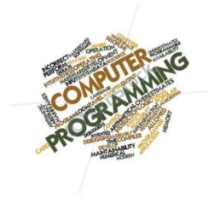
Course Assessment
3 Examination method Mid 1, Mid2, Final
Mid1 15
Mid2 15
Final 50
Assignment/Quizzes/ Projects
20

Slide 3
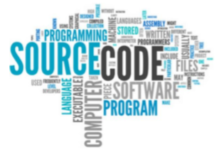
Lecture Notes
All course related material and announcements will be available on slate.

Slide 4

Text Book
Deitel & Deitel “C How to Program”, 6th Edition.

Slide 5
Do’s
1
Put the effort in
Make good use of available resources
2
Attend lectures and labs regularly
Be punctual
3
Lots of Practice.
Remember:
exercises are not enough
Read the books and online material

Slide 6
Don’t
1
Relax too much
Absent in theory and Labs
2
“Borrowing” assignments from “others”.
Remember: They will not help you in the quizzes and exams!!!
Copy paste Culture
Don’t seek help
Don’t understand and don’t ask questions regarding material given in lectures
3

Slide 7
Class Rules
1
Use of mobile is strictly prohibited .
Be disciplined!!!!
2
If you don’t understand a point, raise your hand and ask me to explain
For any query, contact me during my office hours.
3
Remember:
Your first priority must be your studies.
Any kind of Misconduct will not be tolerated

Slide 8
Course Orientation
BASIC THEORETICAL FOCUS
Getting students acquainted with Computer Science concepts and proficient in Problem Solving and Programming Language especially C Language.

Slide 9
The Computer Defined
“Electronic device for storing and processing data, making calculations, or controlling machinery.” (The Pocket Oxford Dictionary)
“An electronic device that processes data, converting it into information that is useful to people.” (Peter Norton)
“A programmable, multiuse machine that accepts data – raw facts and figures – and processes, or manipulates, it into information we can use.” (Williams and Sawyer)

Slide 10
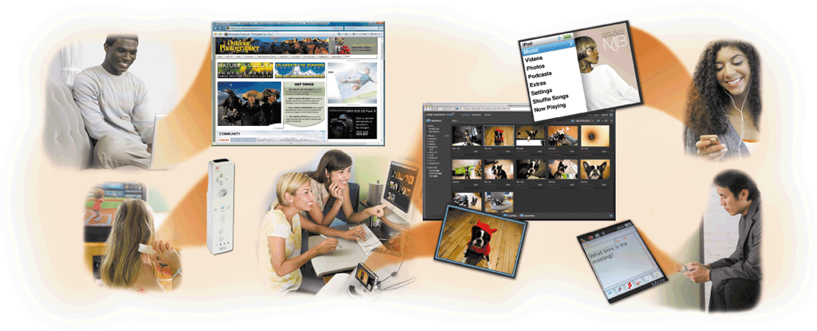
A World of Computers
Computers are everywhere

Slide 11
What’s so special about computer?
It is an electronic device, operating under the control of instructions stored in its own memory.
Produces information (output)
Processing
Collects data (input)

Slide 12
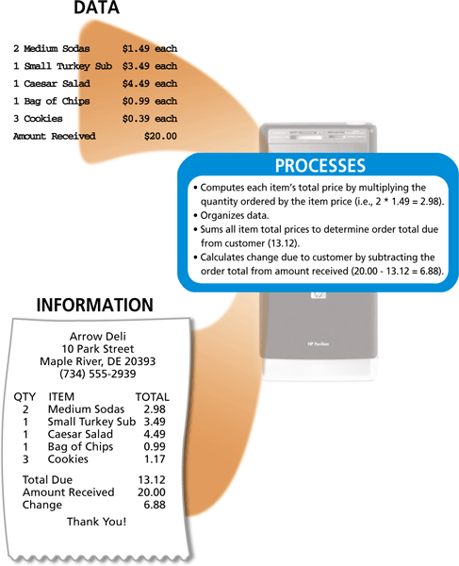
What Is a Computer?

Slide 13
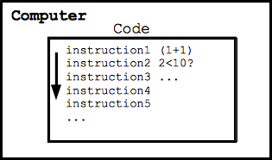
How Does a Computer Work?
The computer follows a series of "code" instructions
Each instruction is simple, mechanical
e.g. add 2 numbers
The computer "runs" a long series of instructions
Purely mechanical

Slide 14
Components of Computer
A computer system consists of both hardware and information stored on hardware. Information stored on computer hardware is often called software.
The hardware components of a computer system are the electronic and mechanical parts.
The software components of a computer system are the data and the computer programs.

Slide 15
Hardware Components of a Computer
A computer contains many electric, electronic, and mechanical components known as hardware
Input Device
Output Device
System Unit
Storage Device
Communications Device
Allows you to enter data and instructions into a computer
Hardware component that conveys information to one or more people
Case that contains the electronic components of the computer that are used to process data
Holds data, instructions, and information for future use
Enables a computer to send and receive data, instructions, and information to and from one or more computers or mobile devices

Slide 16
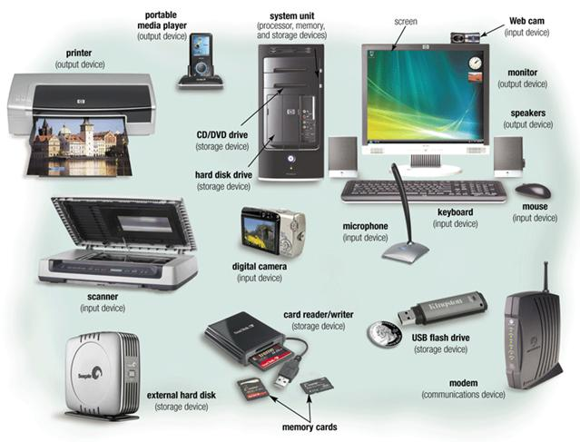
Hardware Components of a Computer

Slide 17
What is Software
The term software is a set of programs , procedures and associated documents( flowcharts, manuals etc.).
Describes the programs and how they are to be used.
Collection of a program whose objective is to enhance the capabilities of the hardware.

Slide 18
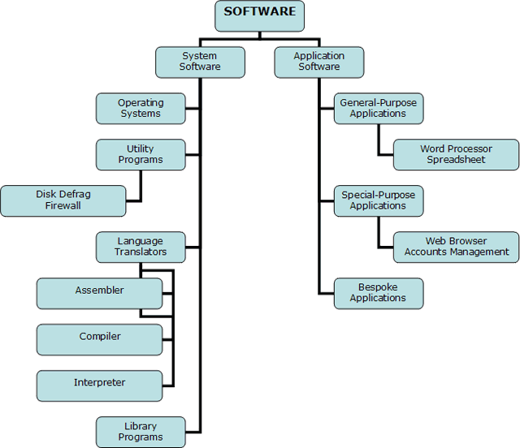
Types of Software
The software can be divided into two categories.
System Software
Application Software

Slide 19
System Software
Designed to control operations and extend the processing capability of a computer system.
The functions of system software are:
Supports the development of other application software.
Supports the execution of other application software.
Monitors effective use of various hardware resources.
Communicate the operations of peripheral devices.
Examples are operating system, program language translator, utility programs etc.

Slide 20
Application Software
Set of one or more program designed to solve a specific problems or do a specific task.
Word Processing
Spreadsheet
Database
PowerPoint

Slide 21
Program Development Cycle
Analyze: Define the problem
Be sure you understand what the program should do.
Have a clear idea of what data(or input) are given.
Relationship between input and the desired output should be cleared.
Design: Plan the solution to the problem
Find a logical sequence of precise steps called algorithm.
Every detail, including obvious steps, should appear in the algorithm.
Choose the interface: Selects the objects.
Determine how the input will be obtained.
Determined how the output will be displayed.
Create appropriate commands to allow the use to control program.

Slide 22
Program Development Cycle
Code: Translate the algorithm into a programming language.
Test and Debug: Locate and remove any errors in the program.
Complete the documentation: organize all material that described the program.
Intend to allow another person, or the programmer later to understand the program.
Documentation includes flowchart and pseudocode.

Slide 23
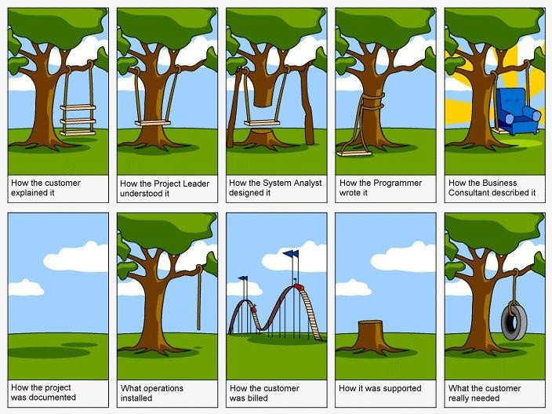

Slide 24
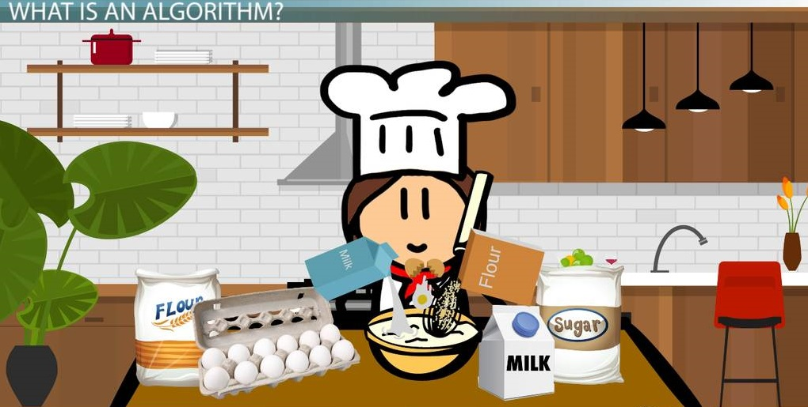
Algorithm
The term algorithm is often used to refer to the logic of a program.
Should be precise and unambiguous.
Instruction should be such that it can be performed in a finite time.
Ensure the termination of algorithm.
Tools used to convert algorithms into computer programs:
Pseudocode
Flowchart.

Slide 25
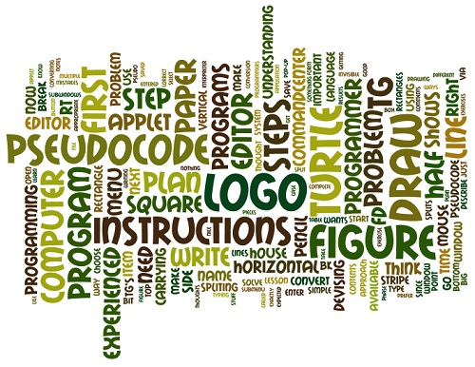
Pseudocode
An informal high level description of the operating principle of a computer program.
It uses the structural conventions of a programming language.
Understandable for human reading rather than machine reading.

Slide 26
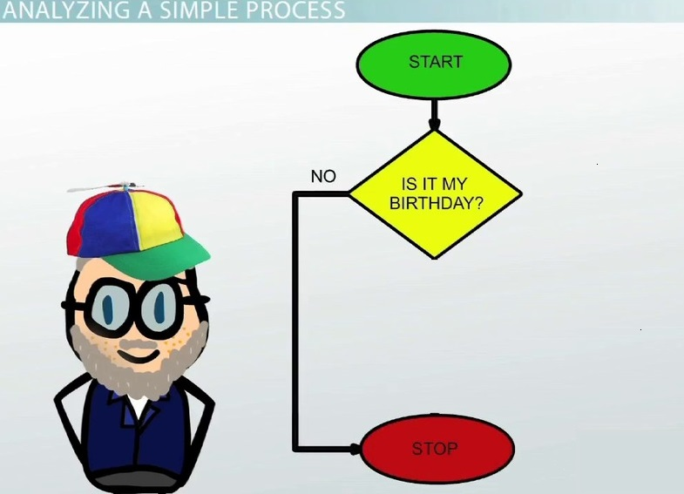
Flowchart
A pictorial representation of an algorithm.
Plan to be followed when the corresponding algorithm is converted into a program by writing in a programming language.
It is roadmap for a programmer.

Slide 27

Summary
If we had to summarize the intellectual contribution of computer science in one word, it would be “reduction”.
Computer scientist solve problems by reducing them to simpler problem.

Slide 28
References
P.K. Sinha & Priti Sinha, “Foundations of Computing”, Customized Edition for C-DAC Courses. (Chapter 1)
Donald H. Sanders, “Computers Today”, 3rd Edition. (Chapter 1)

